Slide 1
Anti-Civilian Violence
Project 3
By Shannon, Diana & Shola
Notes:
SHOLA
Welcome to our presentation on Anti-Civilian Violence
Throughout our presentation we will use a combination of presentation slides and demonstrate the website we’ve created to house our interactive visualisations.
Over to Shannon to briefly explain our theme.

Slide 2

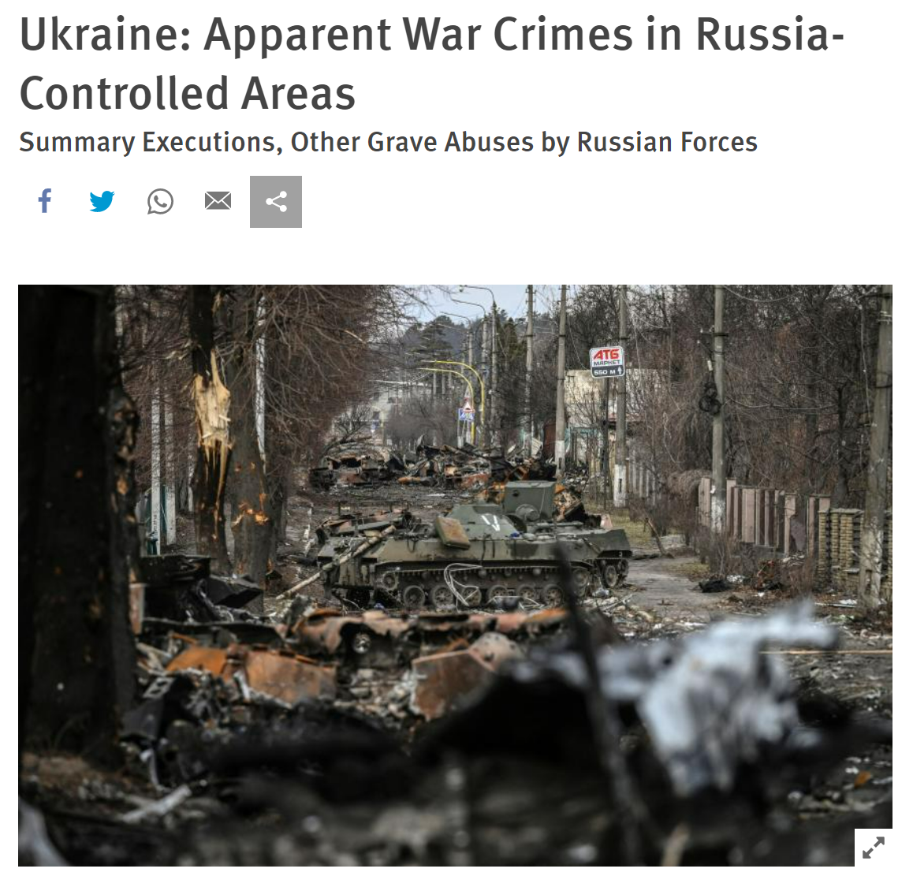

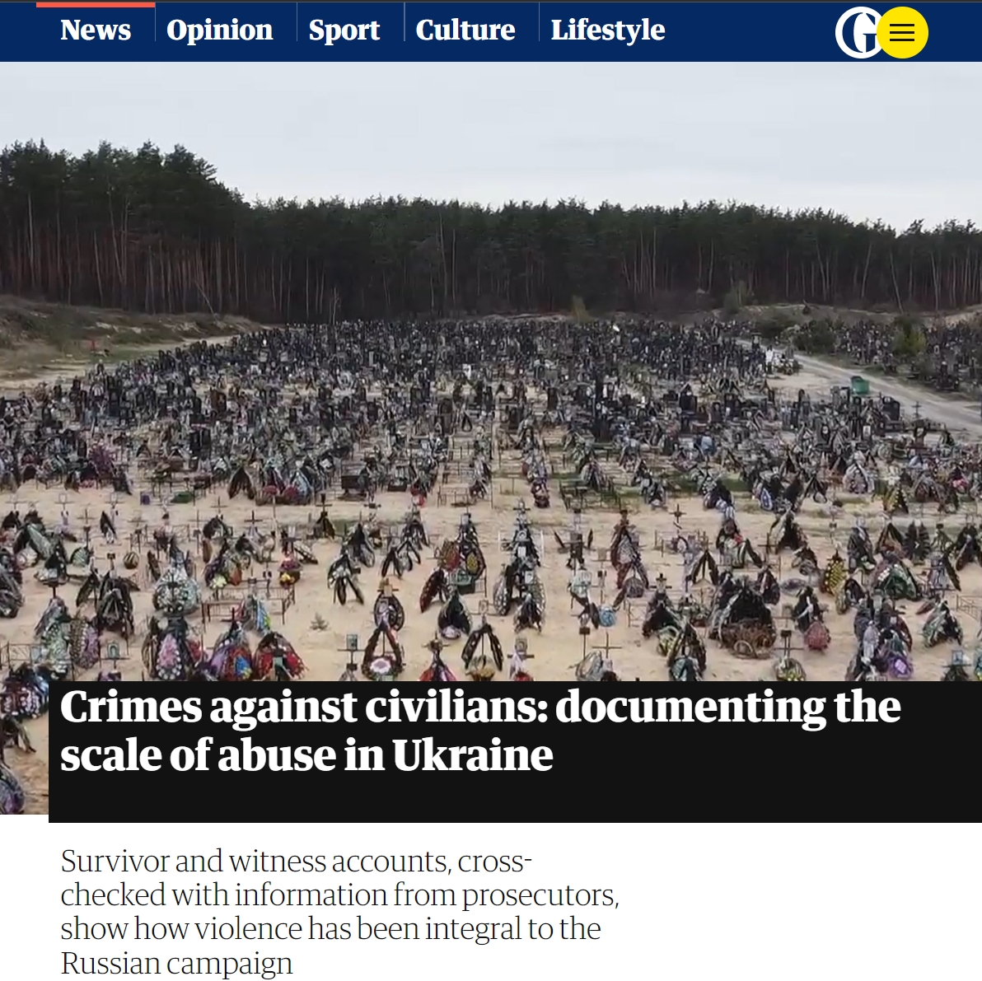
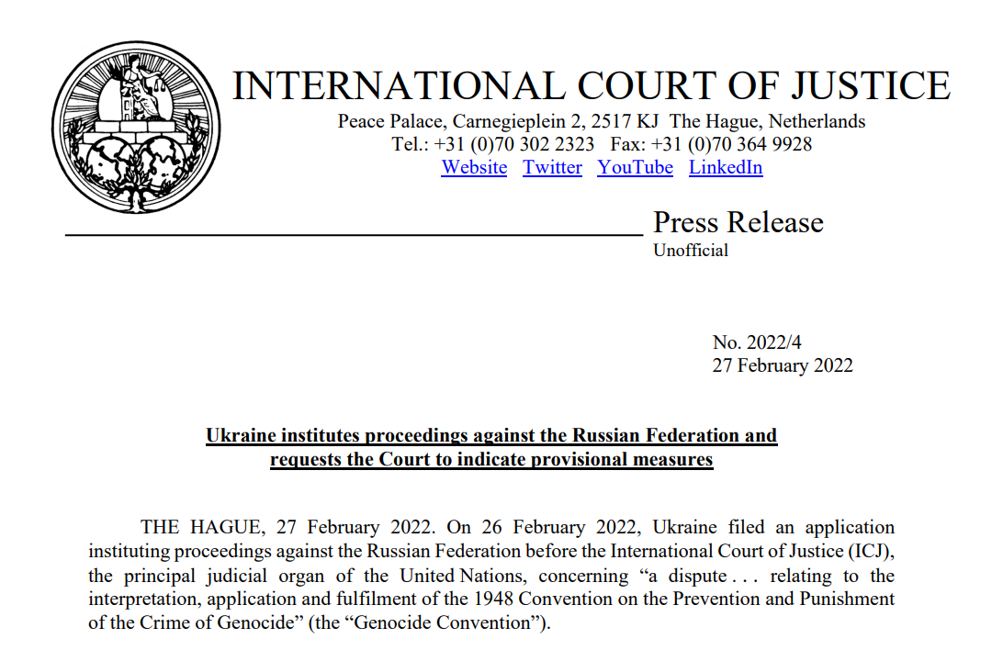
Theme: Violence Against Civilians
Global news
Armed Conflict Location & Event Data Project (ACLED) dataset
Importance of focus and analysis
Implications
Further Analysis
Notes:
SHAN
Violence against civilians
Global News:
Ukraine at forefront of global news
Violence against civilians has been highlighted frequently in news outlets
Violence against civilians (which includes sexual violence, abduction etc) is notoriously hard to document and is its suspected that in all conflicts, especially the Russian / Ukraine war that sexual violence is not reported and remains a hidden tool of terror used by Russian troops to control Ukrainian civillians. This has repercussions for human rights, international war courts, and other issues such as trauma relating to gender based violence, trafficking and modern slavery, and fundamentally the future of Ukraine as a modern state. Indeed, more imminently this also affects questions and debates of NATO intervention which will have monumental consequences for the world.
Dataset:
ACLED (The Armed Conflict Location & Event Data Project) dataset
ACLED is a research NGO
The project: data collection, analysis, and crisis mapping project. ACLED collects the dates, actors, locations, fatalities, and types of all reported political violence and protest events around the world. The ACLED team conducts analysis to describe, explore, and test conflict scenarios, and makes both data and analysis open for free use by the public.
Importance of focus and analysis:
VAC includes genocide, mass killings, and terrorism
International humanitarian law includes the protection of persons not or no longer taking part in hostilities - war crimes are violations of international humanitarian law (treaty or customary law) that incur individual criminal responsibility under international law.
Implications:
World: Violence against civilians - especially the more hidden elements which can include sexual violence is important to highlight as there needs to be more prevention and protection to civilians in periods and events of conflict.
Further analysis:
We began our focus on Ukraine then we wanted to compare this type of conflict across the globe and see if we could find any patterns or anomalies.
References:
Humans Rights Watch (2022) https://www.hrw.org/news/2022/04/03/ukraine-apparent-war-crimes-russia-controlled-areas (accessed 01.07.22).
The Guardian (2022) https://www.theguardian.com/world/2022/may/19/vadim-shishimarin-russian-soldier-asks-ukrainian-widow-to-forgive-him-during-first-war-crimes-trial (accessed 01.07.22).
Sources:
ACLED https://acleddata.com/#/dashboard (accessed 23.06.22).

Slide 3











Coding Approach
Cleaning Data
Creating SQLAlchemy DB and connecting DF
Flask API
Web (HTML, CSS & Bootstrap)
Javascript and data visualisations
Data Wrangling Techniques
Notes:
DIANA
Cleaning Data
Used Python and Pandas to clean data and delete unwanted columns and recorder.
Creating SQLAlchemy DB and connecting DF
Created DB connection. Loaded data into SQL DB
Flask connection
Created various app routes using flask to filter the large dataset into more manageable datasets
Created geojsons inside routes to be able to map out data and visualise.
HTML & CSS structure
Used bootstrap, HTML, CSS to create web-page structure
Javascript and data visualisations
Used Leaflet, Plotly and Amcharts

Slide 4
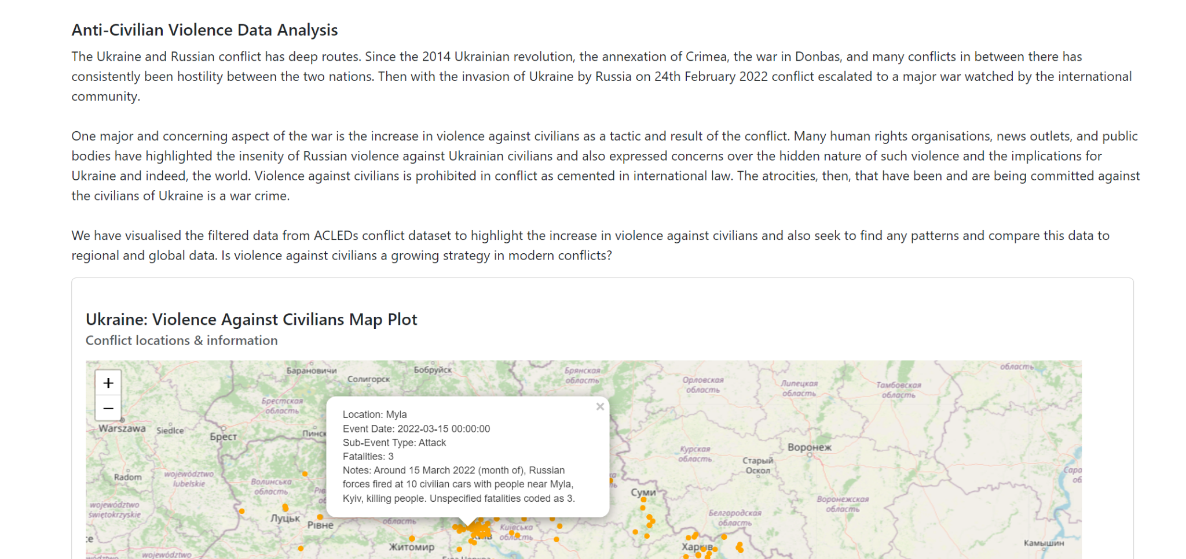
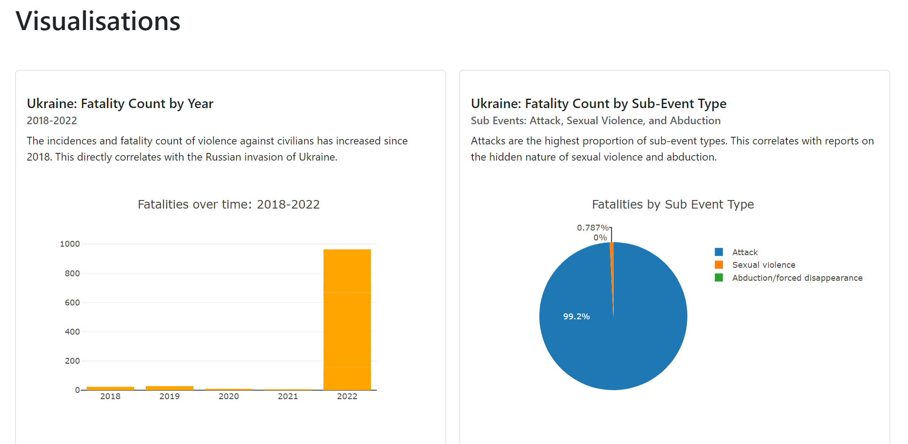
Region: Ukraine
Year: 2018-2022
Notes:
SHAN
Ukraine: major increase in violence against civilians since Russian invasion of Ukraine in Feb 2022.
Exponentially - increased
Supports claims that violence against civilians has increased and highlights immorality and illegality of Russian actions in Ukraine.
Sexual violence event type = very small. This is comparison with major human rights and GBV orgs stating that these instances are more hidden suggests that the data collected by ACLED & news outlets does not record these types of conflict types.
This also highlights implications for war, conflict and gender based violence.

Slide 5
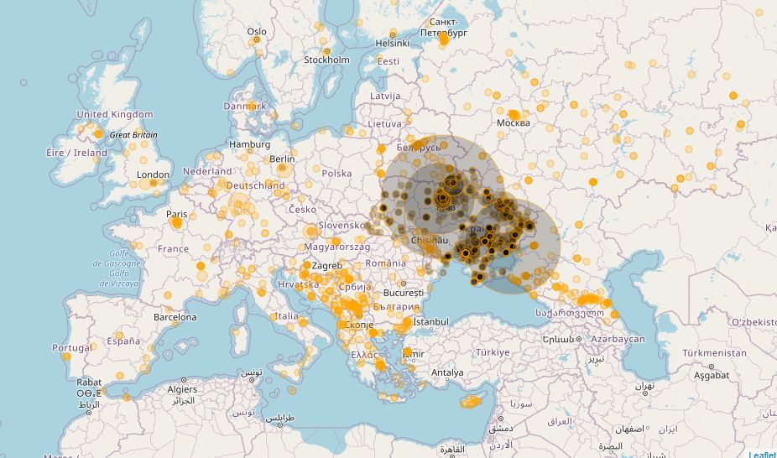
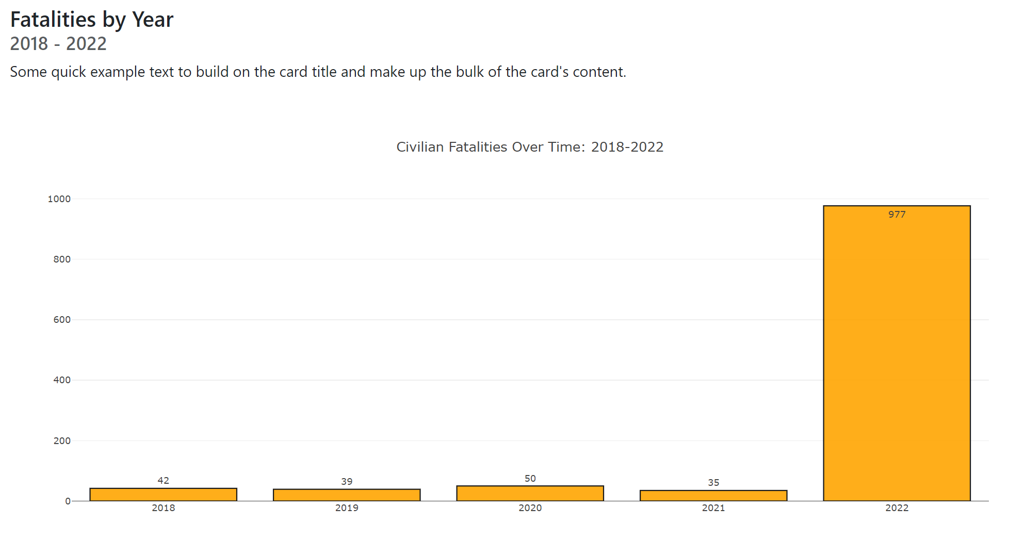
Region: Europe
Year: 2018-2022
Europe is characterised by a low rate of violence against civilians (events and fatalities). But this number has risen sharply in 2022 due to the war in Ukraine.
Notes:
DIANA
Violence against civilians is very low in Europe compared to other regions around the world.
You can see the rise in fatalities as a result of civilians in 2022 - which is largely due to the Russian - Ukraine war.
(The other events seem sporadic and non related? Too generic?)

Slide 6
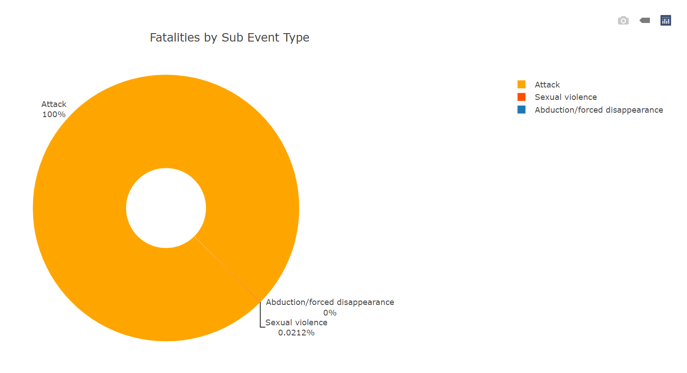
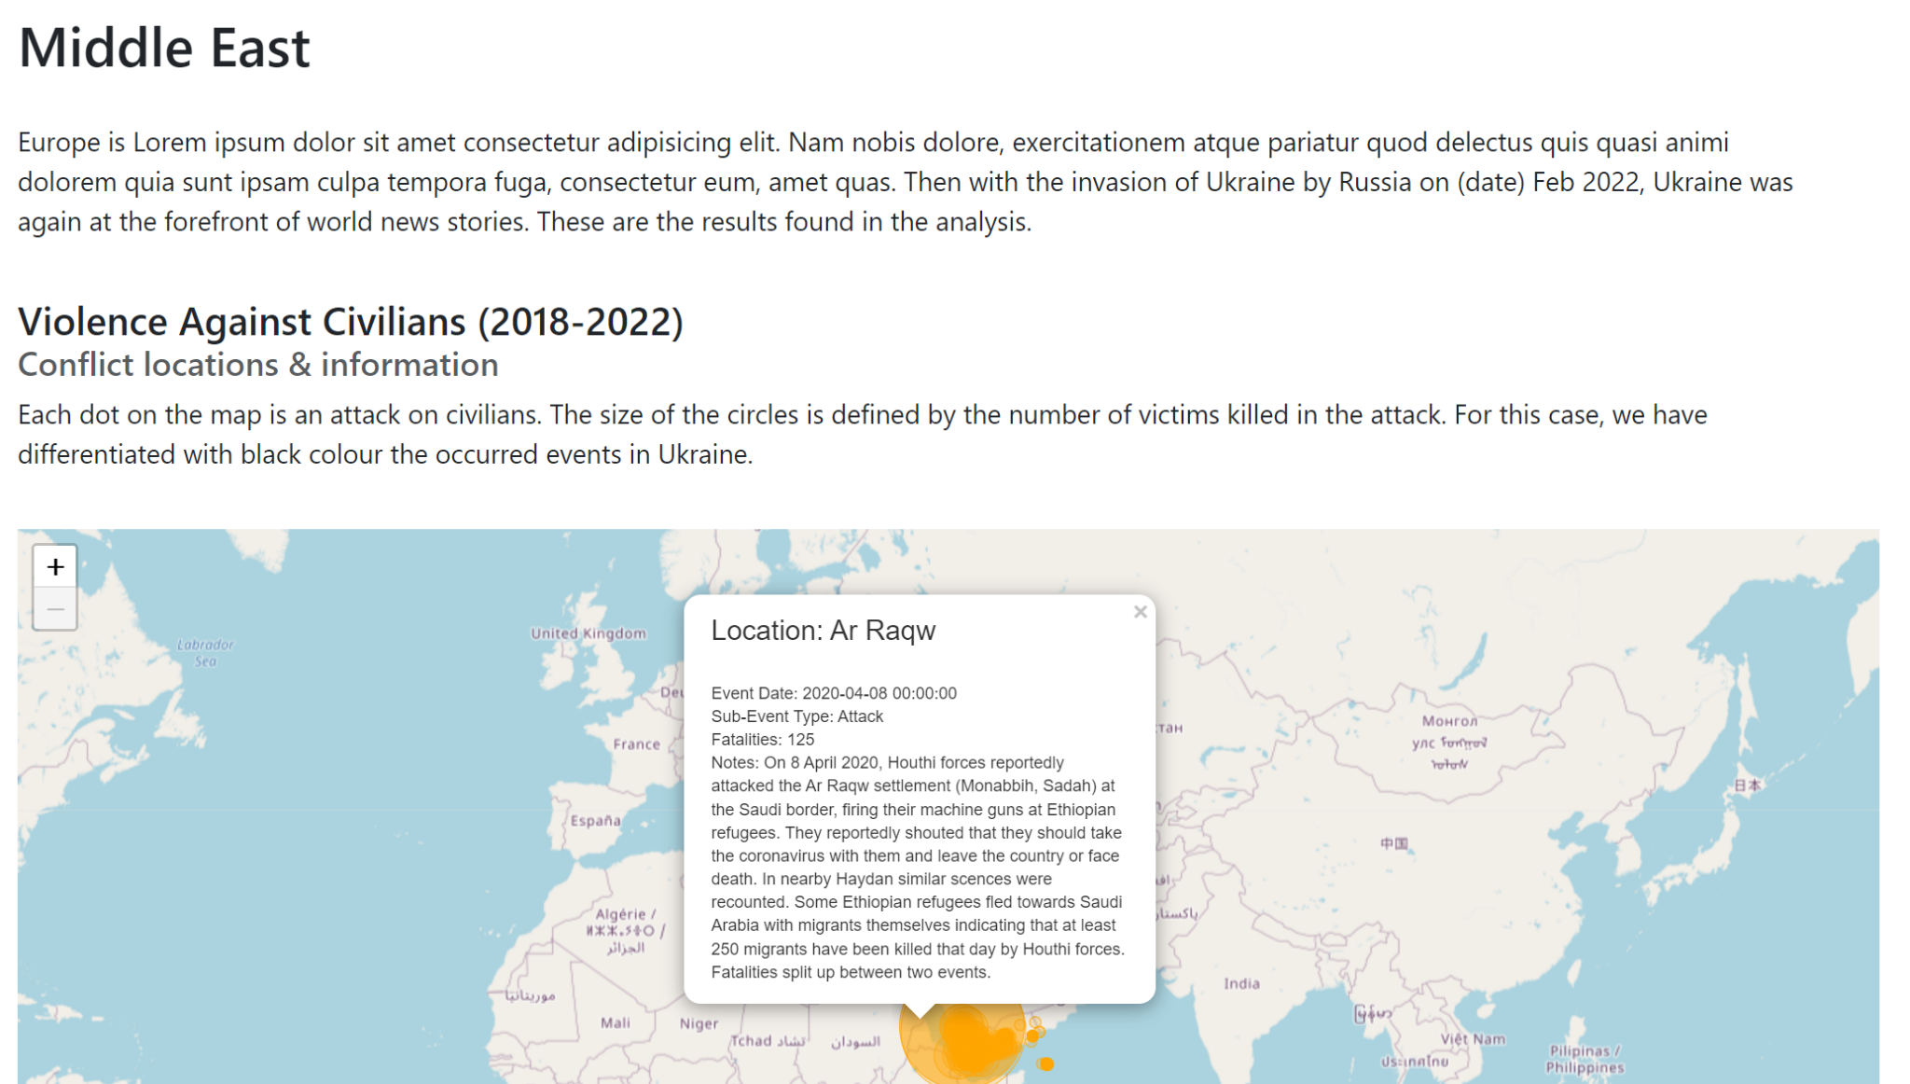
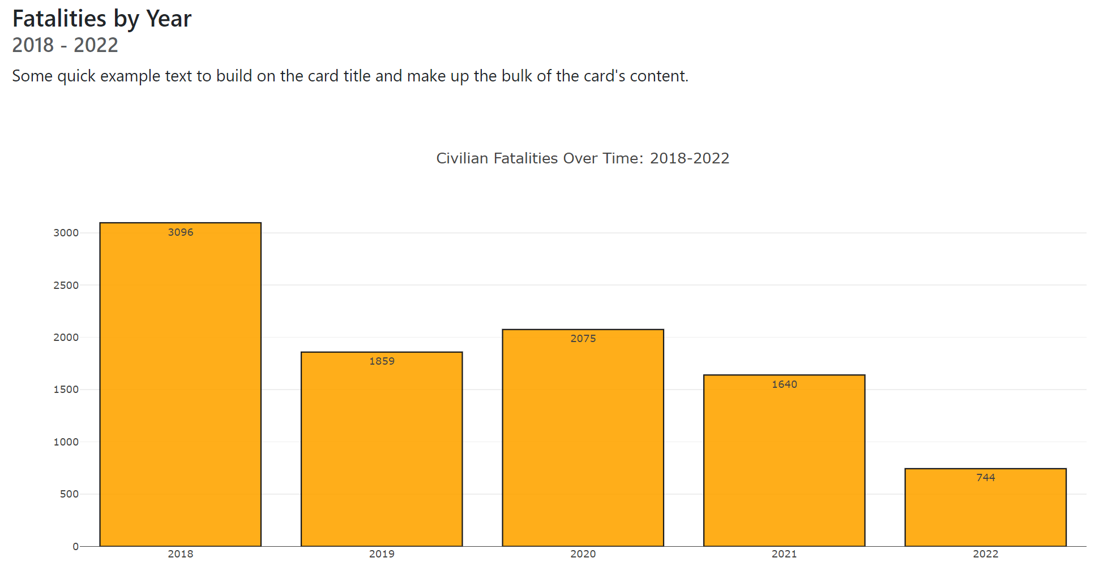
Region: Middle East
Year: 2018-2022
Notes:
SHOLA
Violence against civilians and resulting fatalities in the Middle East is much higher than in Europe. However, we can see a year on year decrease which depicted the reverse pattern of Europe.
This may be due to many civil wars in the Middle East including in Syria and Yemen.
Abduction and sexual violence are almost at zero - however, again, similar to Ukraine, but this could be due to hidden nature of crime and potential lack of recording.

Slide 7
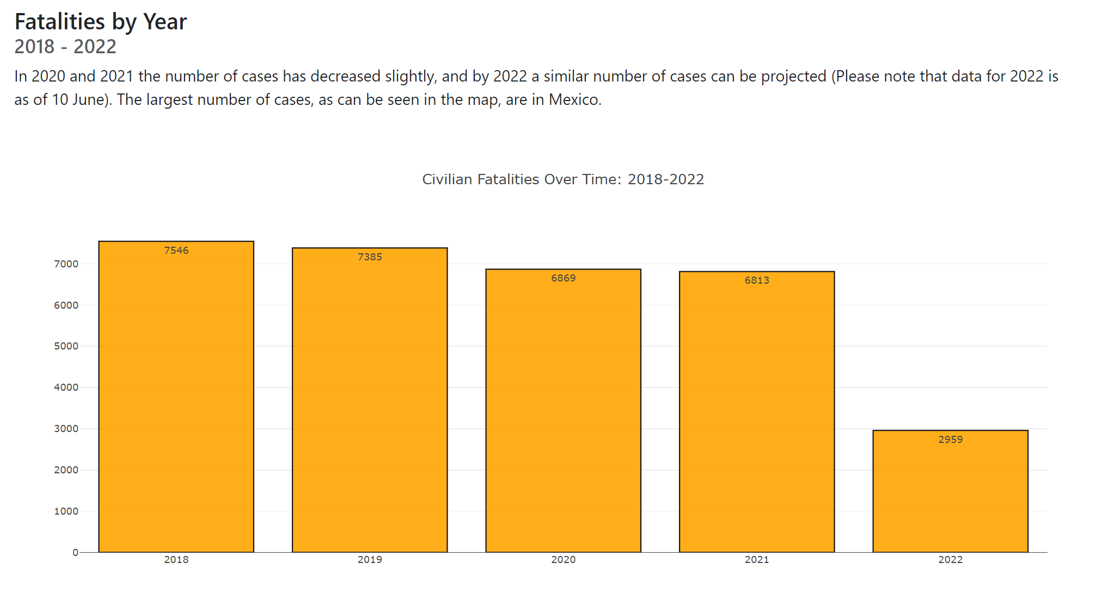
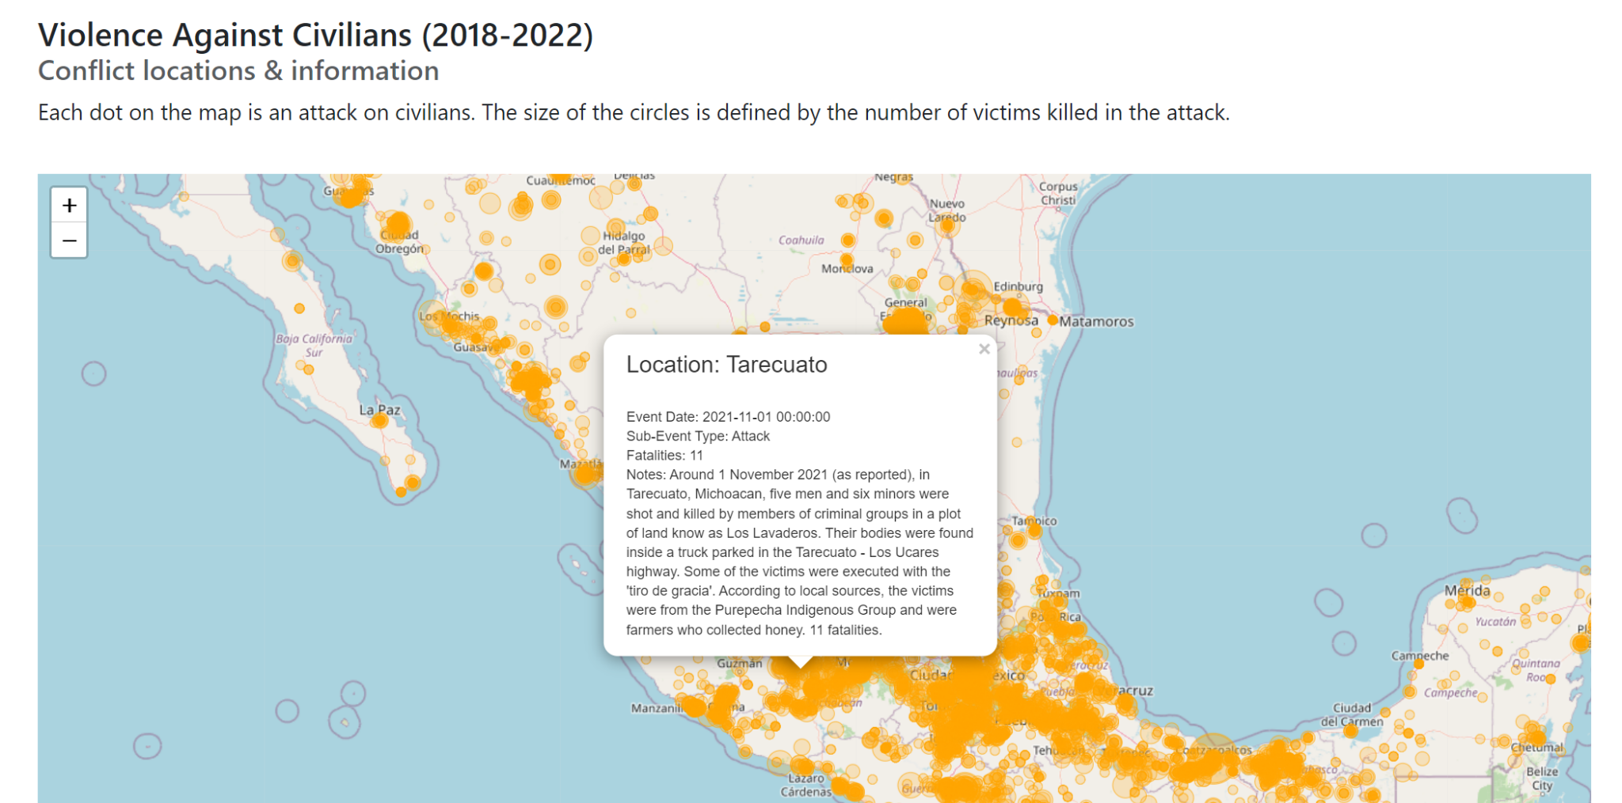
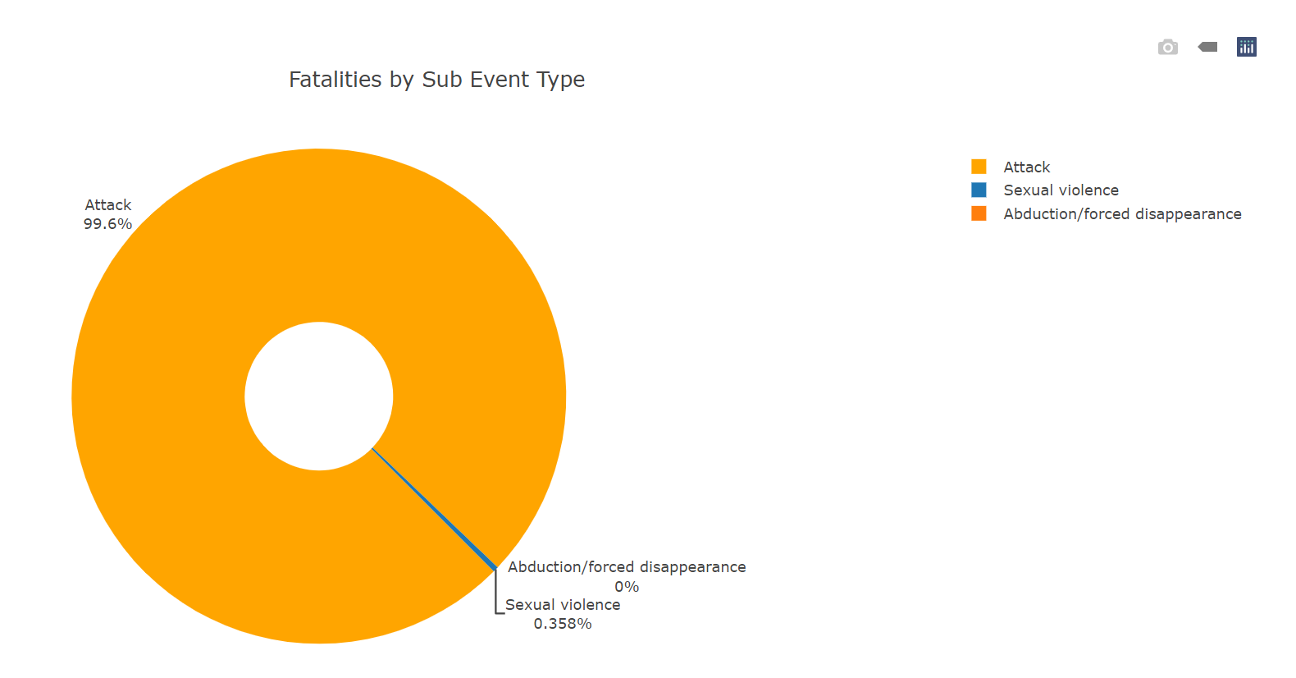
Region: North America
Year: 2018-2022
Notes:
SHAN
North America - the map highlights that there is more violence against civilians events in the southern states of America than in the North. It also highlights that there is more conflict on Mexico than the USA. Many of the conflict events also mention use of torture.
The fatality count for each year since 2018 in comparison is higher than SA, EU, and the ME.
This may reflect the high number of drug cartel related conflicts in Mexico where civilians have notoriously been caught up in the violence. Interestingly the perps are described as ‘unidentified gang members’ in the ACLED dataset which marks a significant difference to the Ukraine data where the violence against civilians is carried out by soldiers of a nations military.
NA follows a similar trend to the rest of the regions in that there is not a lot of reported SV.

Slide 8
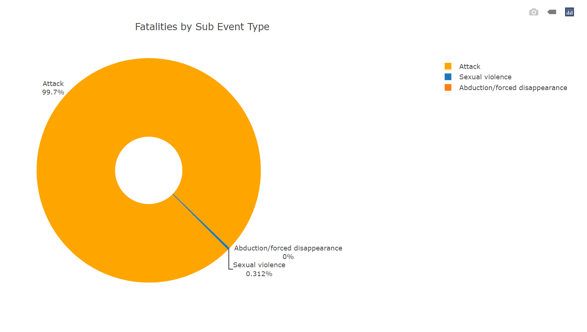
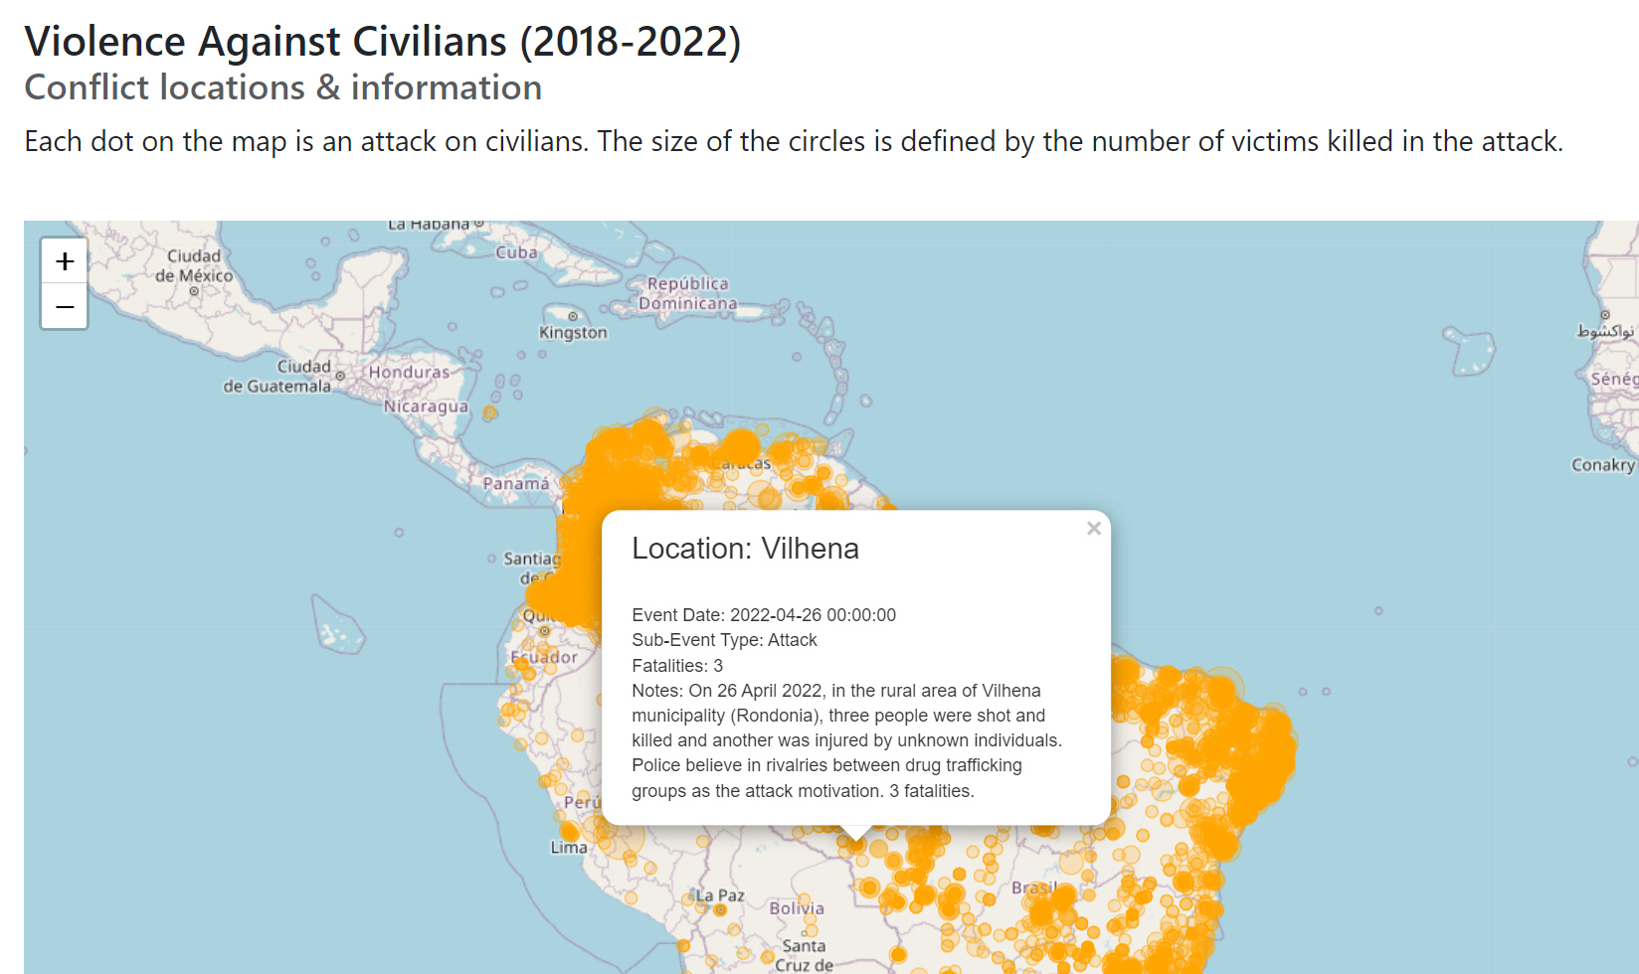
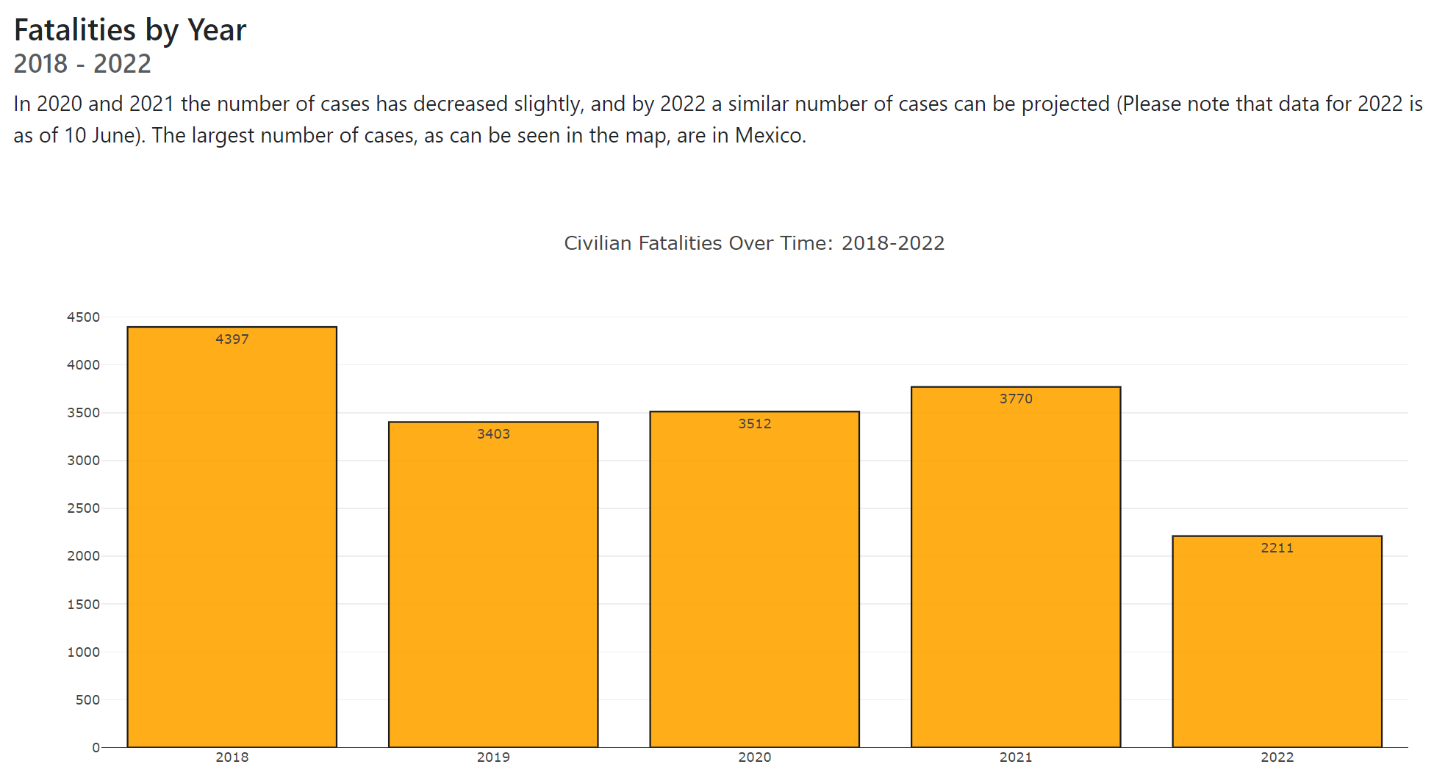
Region: South America
Year: 2018-2022
Notes:
DIANA
Violence against civilians in SA is largely concentrated in Columbia and Brazil. Indeed, this may reflect the notorious police violence in Brazil, and civilians getting caught up in the infamous guerrilla warfare in colombia.
The fatality rate for this event type is higher than Europe and the Middle East per year. This highlights that in SA & Mexico there are more fatalities as a result of violence against civilians than the other regions. The reasons for this may be due to the political and social unrest and the government war on drugs strategies. It would be interesting to delve deeper into why this region has the highest number of fatalities.
NA follows a similar trend to the rest of the regions in that there is not a lot of reported SV.

Slide 9
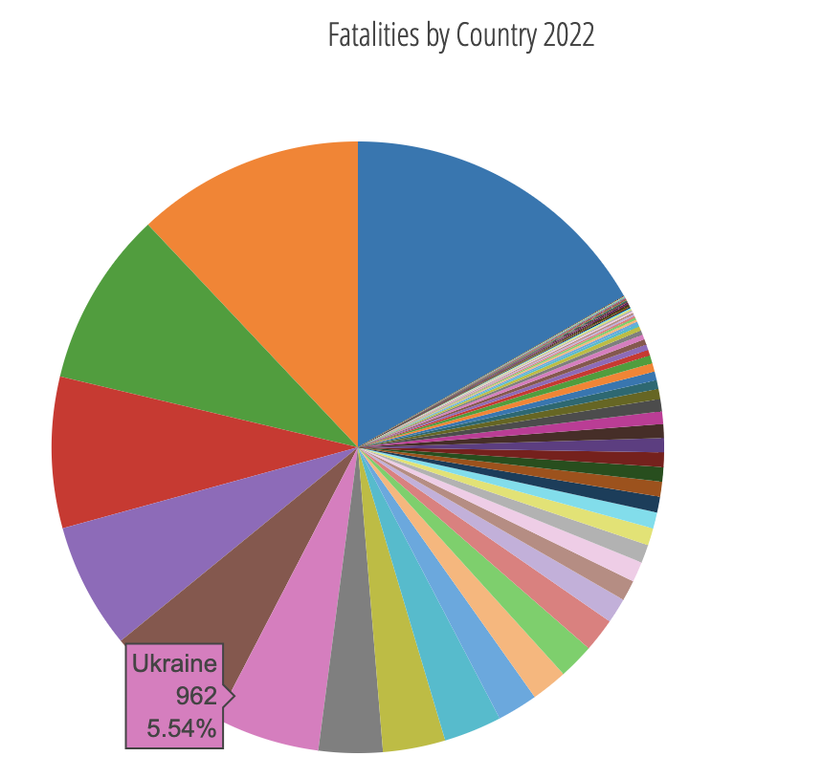
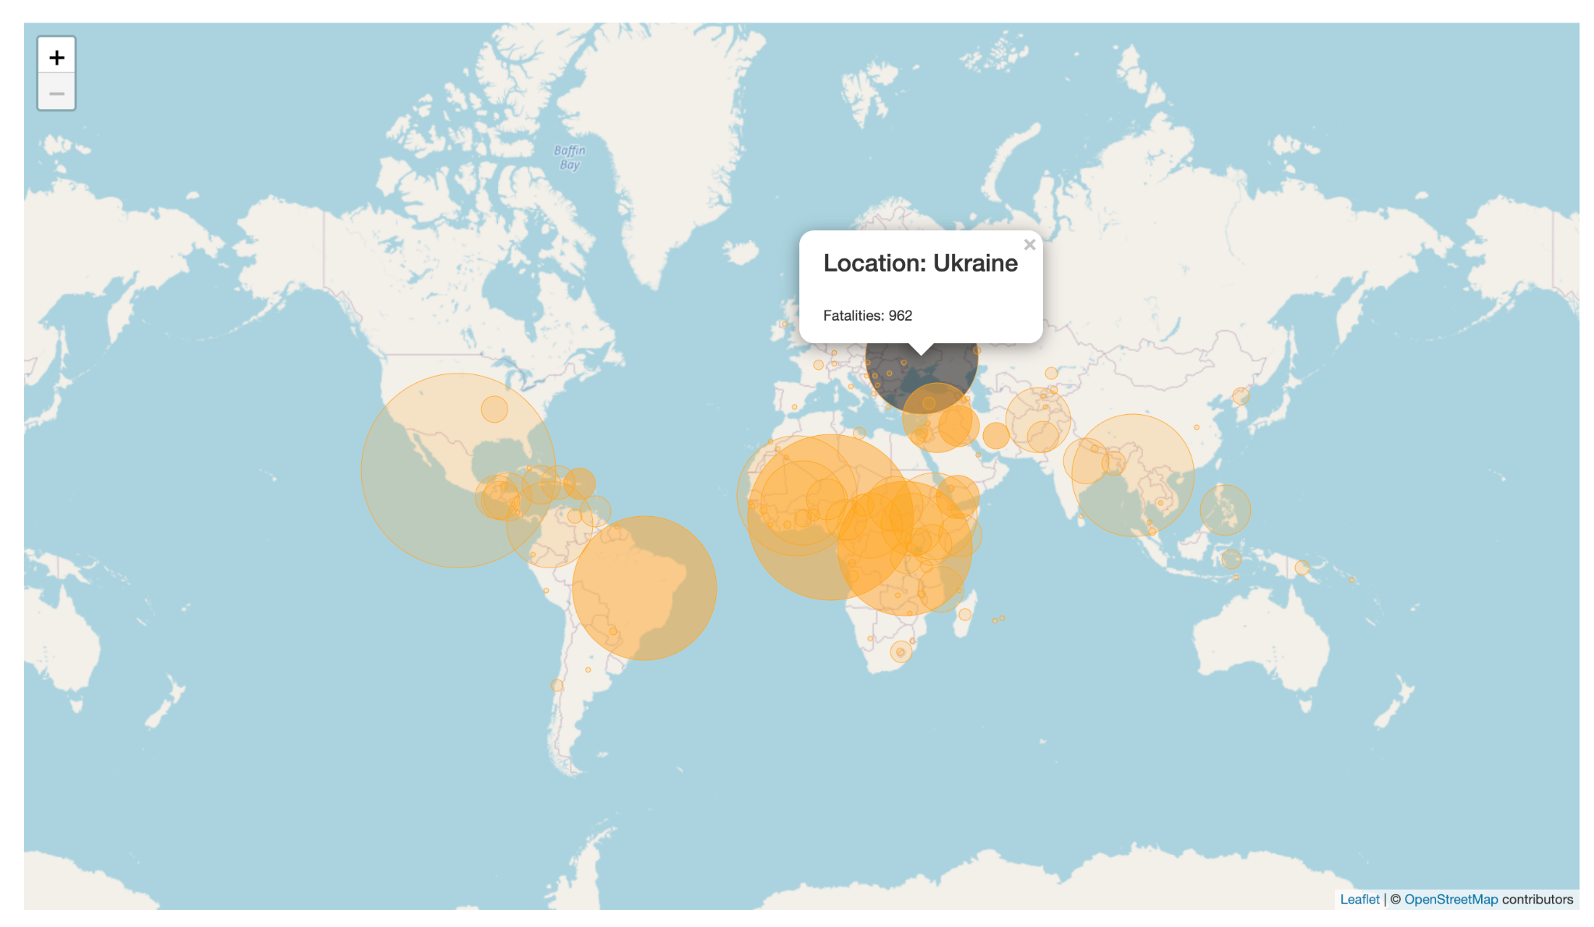
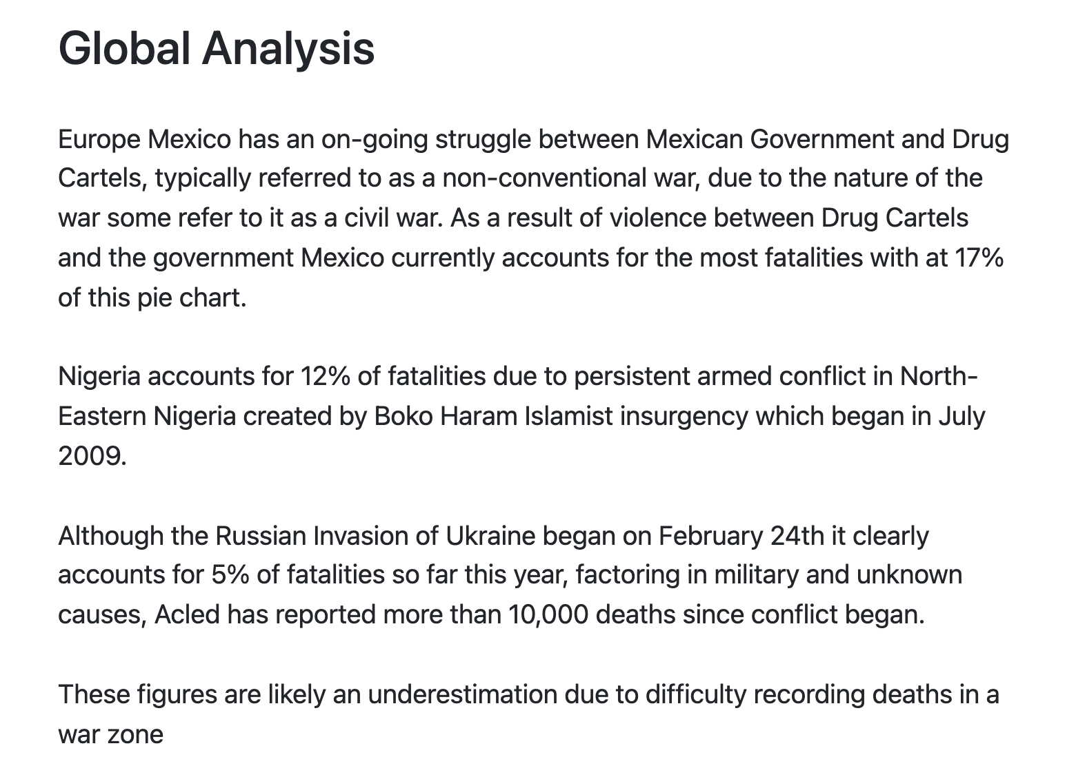
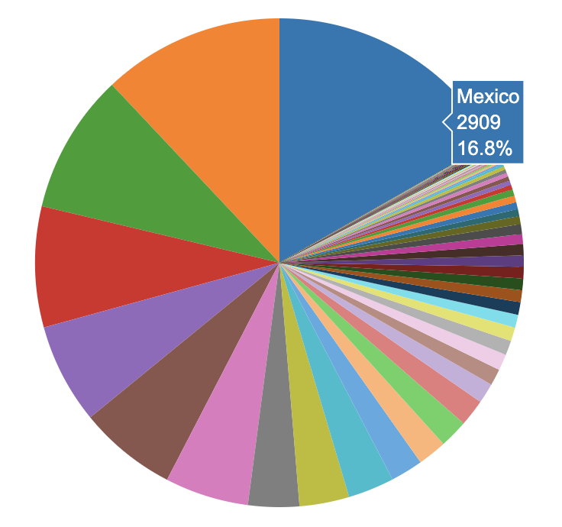
Global Fatalities
Year: 2022
Notes:
SHOLA
Since the current events taking place in Ukraine was our starting point for our project as we wanted to see how impactful anti-civilian violence was, specifically how fatalities fared against other parts of the world
Our global overview analysis data from January – June 2022.
With nearly 1000 anti-civilian fatalities this year, Ukraine accounts for over 5% of this pie chart.
Mexico has an ongoing struggle between Mexican Government and Drug Cartels, typically referred to as a non-conventional war, due to the nature of the war some refer to it as a civil war.
As a result of violence between Drug Cartels and the government Mexico currently accounts for the most fatalities with at 17% of this pie chart.

Slide 10
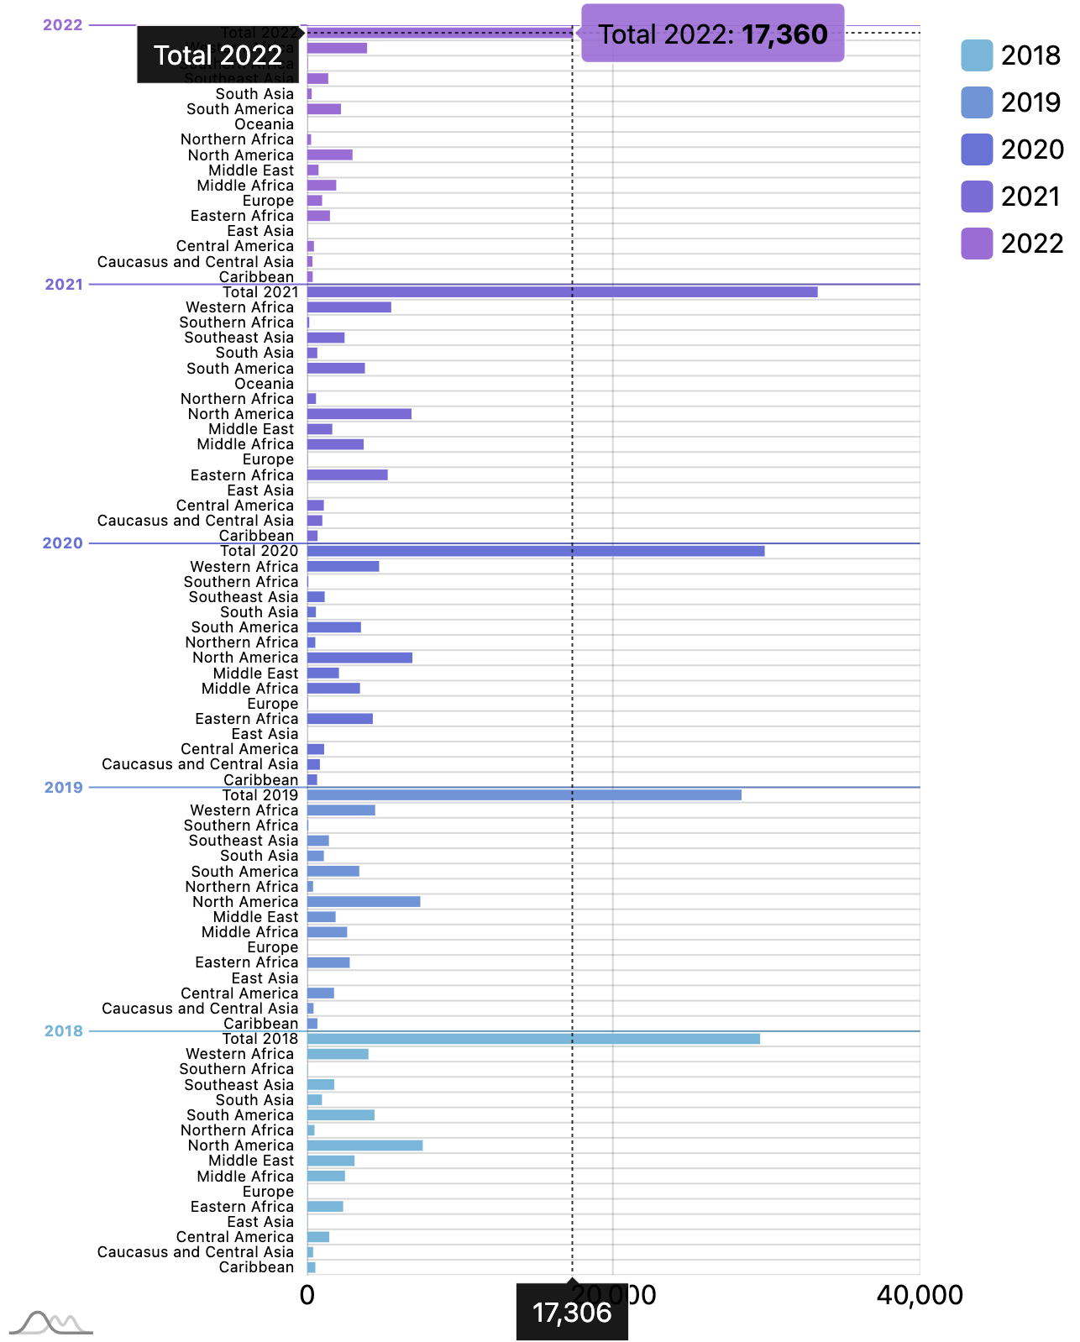
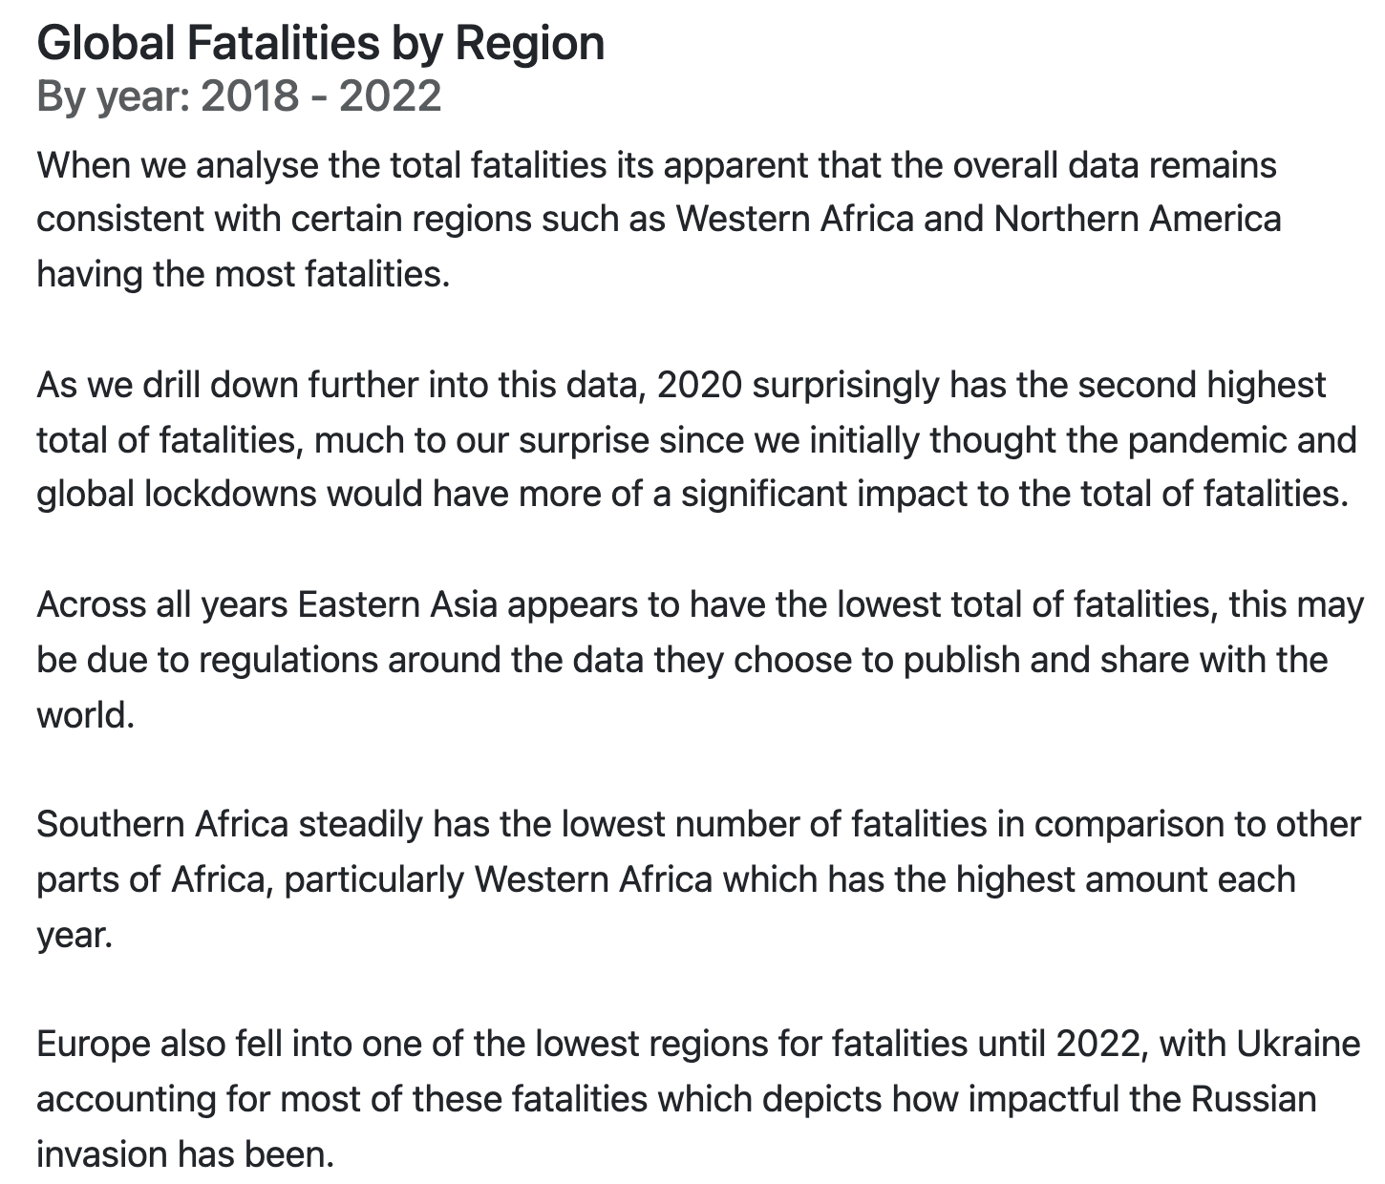
Global Fatalities
Year: 2018-2022
Notes:
SHOLA
Our global analysis considers all fatalities by region from 2018-2022
Much to our surprise the pandemic and global lockdowns didn’t play a factor in total fatalities for 2020, in fact the total was more than the previous year by 1,500 fatalities.
Some regions remain consistent throughout the data showing ongoing wars in these areas.
Eastern Africa shows a noticeable increase each year, Western Africa consistently remains at a high level of fatalities, while Southern Africa remains at one of the lowest for fatalities.
When we drill down at the data even further Europe also fell into one of the lowest regions for fatalities until 2022, with Ukraine accounting for most of these fatalities.

Slide 11
Q&A
Notes:
Thank you for listening to our presentation, we welcome any questions.

